Slide 1


Age as a susceptibility factor for SARS-CoV-2 infection
Dr Kirsty Short
School of Chemistry and Molecular Biosciences
Faculty of Science
@K_RenfreeShort

Slide 2


Children spread influenza

Slide 3


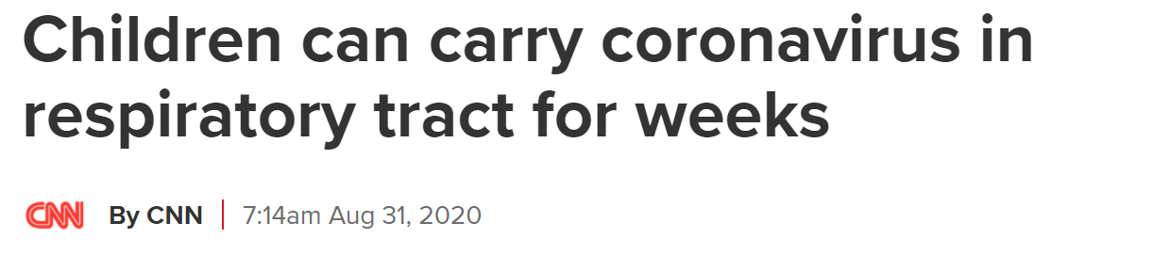
Children and the spread of SARS-CoV-2 is controversial

Slide 4

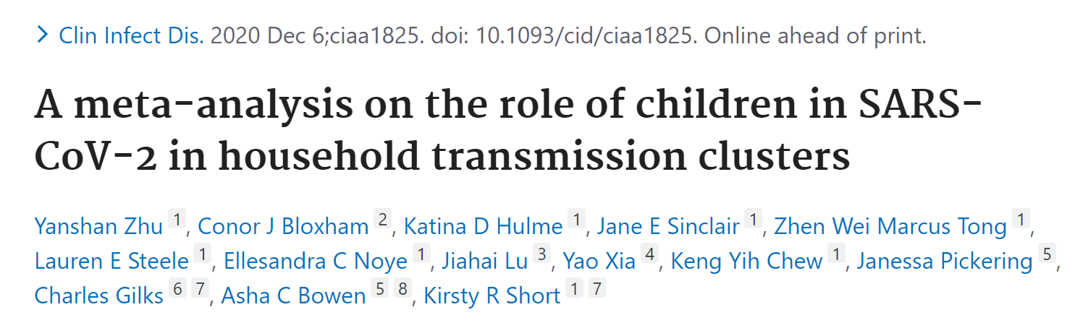
Household transmission clusters: How likely are children to be the index case?
Household transmission cluster of COVID-19
Identified the index case of the cluster
Defined the number of infected individuals in the cluster

Slide 5
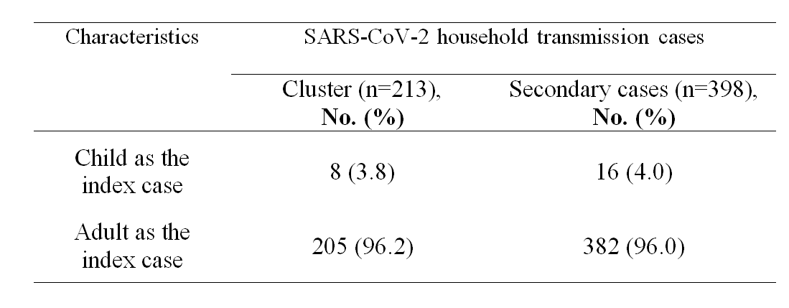
Household transmission clusters: How likely are children to be the index case?

Slide 6
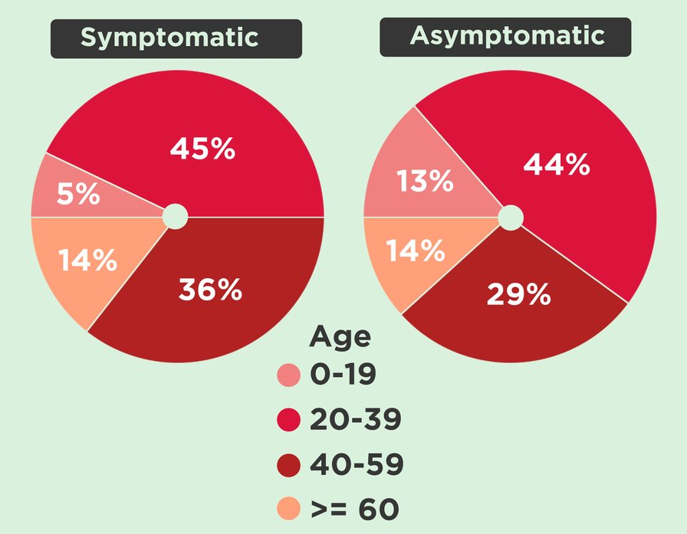
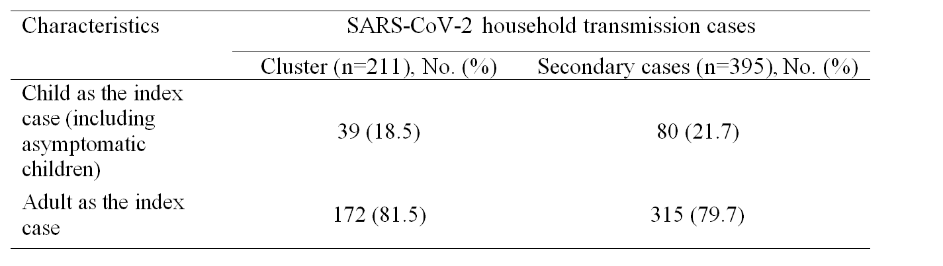
Household transmission clusters: How likely are children to be the index case?

Slide 7
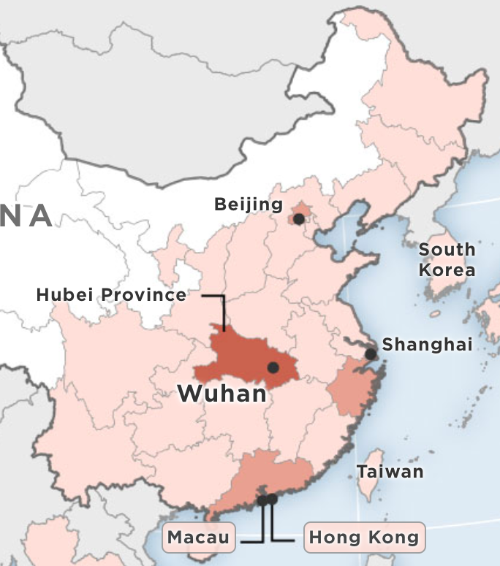
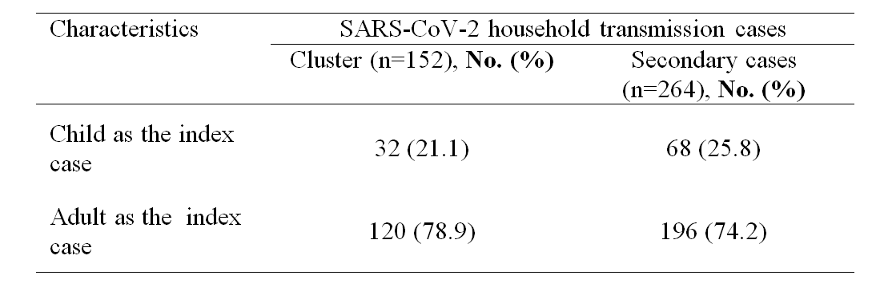
Household transmission clusters: How likely are children to be the index case?

Slide 8
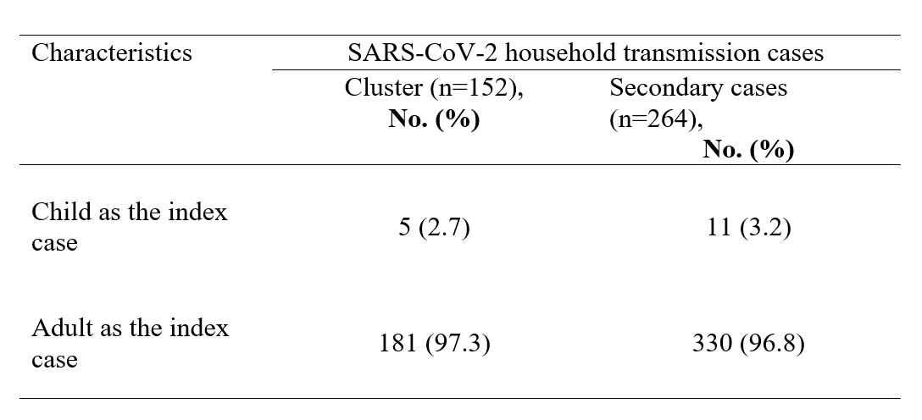

Household transmission clusters: Affected by the lockdown?

Slide 9
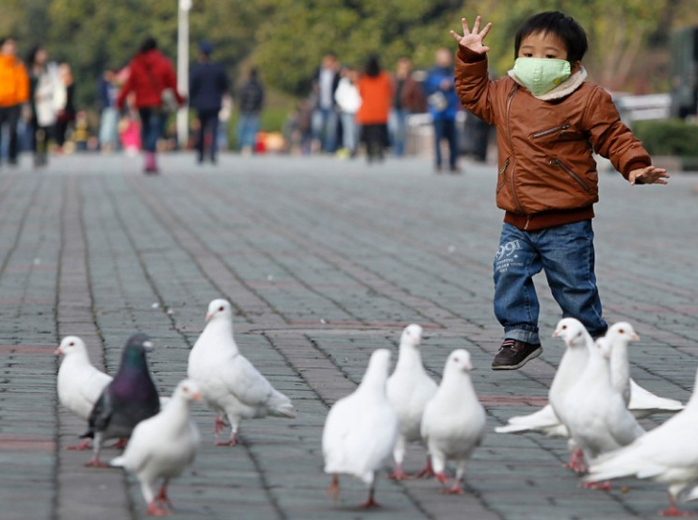
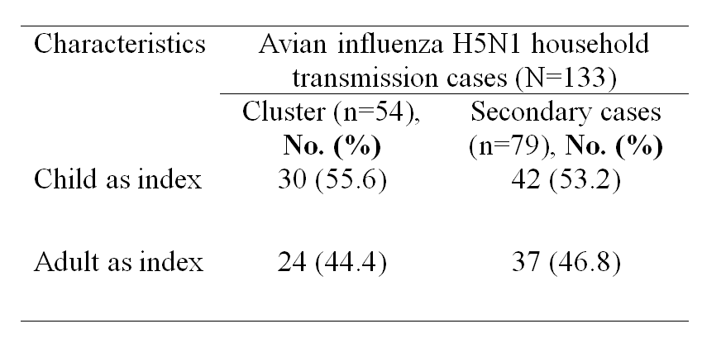
Avian influenza is a very different story…

Slide 10
Household transmission clusters: how likely are children to be infected?
Household transmission cluster of COVID-19
Defined secondary attack rate within the cluster
Defined the age of contact cases in the clusters

Slide 11
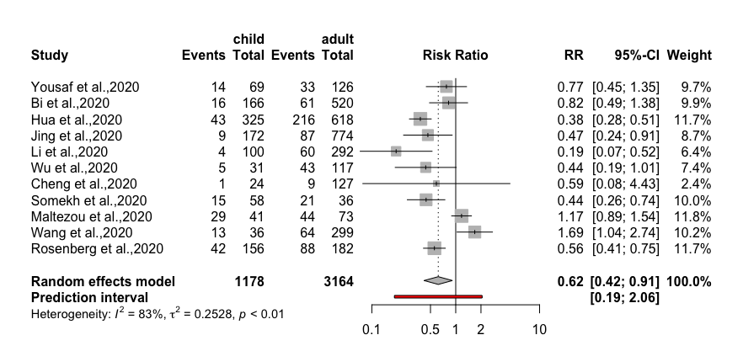
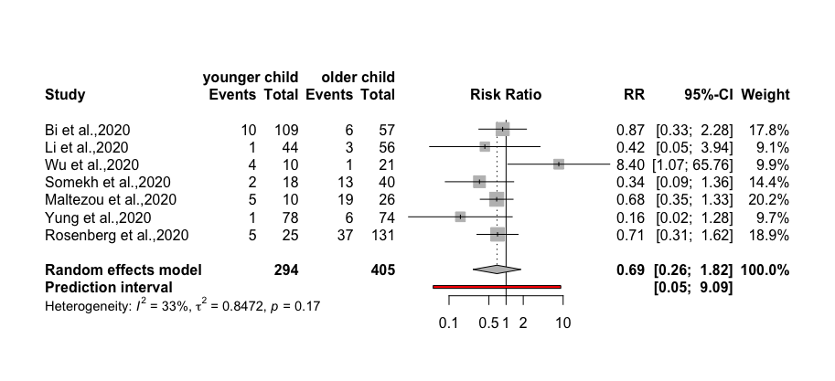
How likely are children to acquire SARS-CoV-2 in the home?
Children vs adults
Younger children vs older children

Slide 12
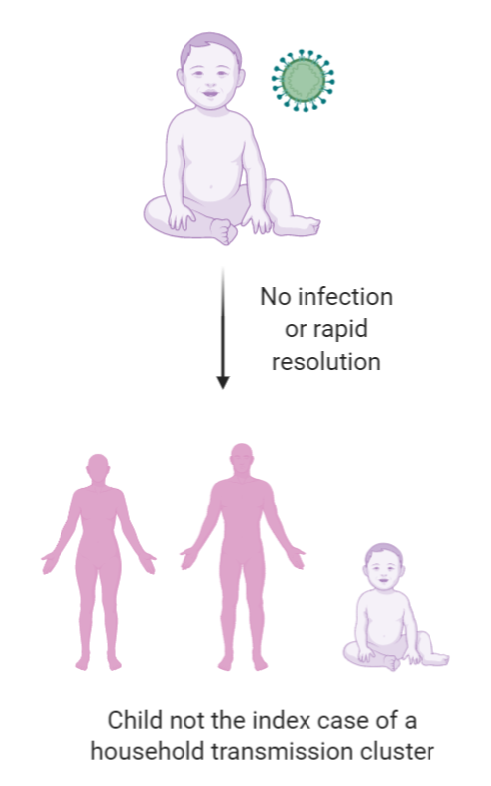
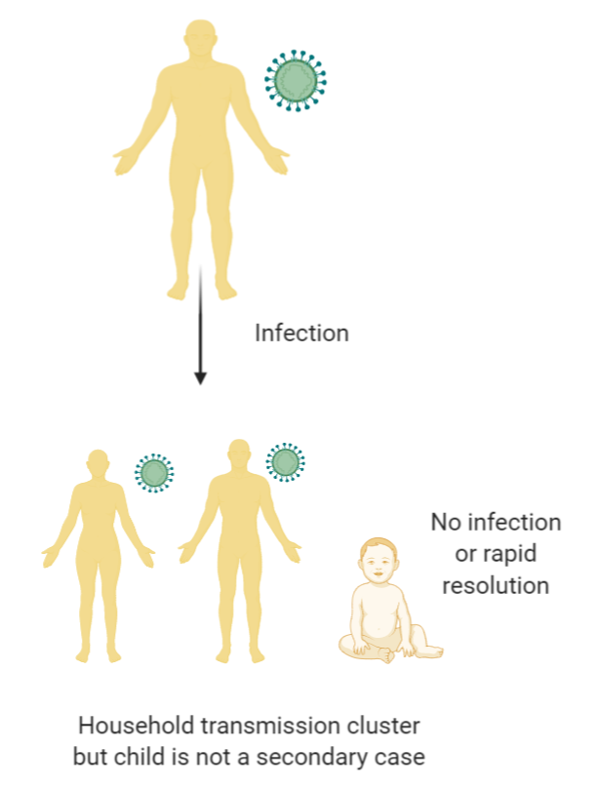
Why would children be more resistant to infection?

Slide 13
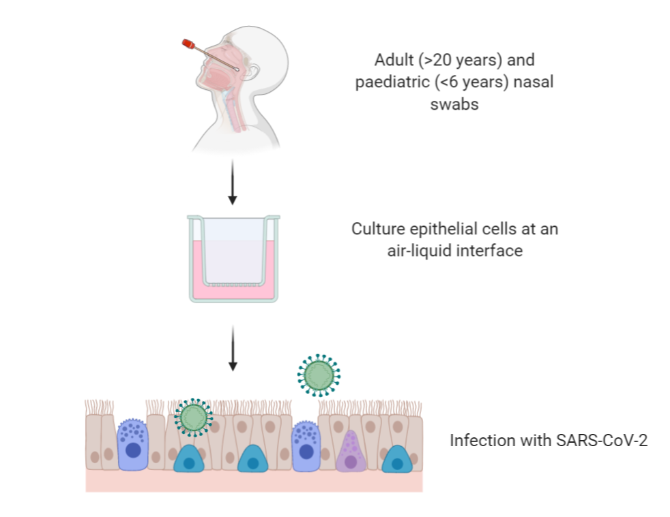
Is there something fundamentally different in the anti-viral response of paediatric nasal epithelial cells?

Slide 14
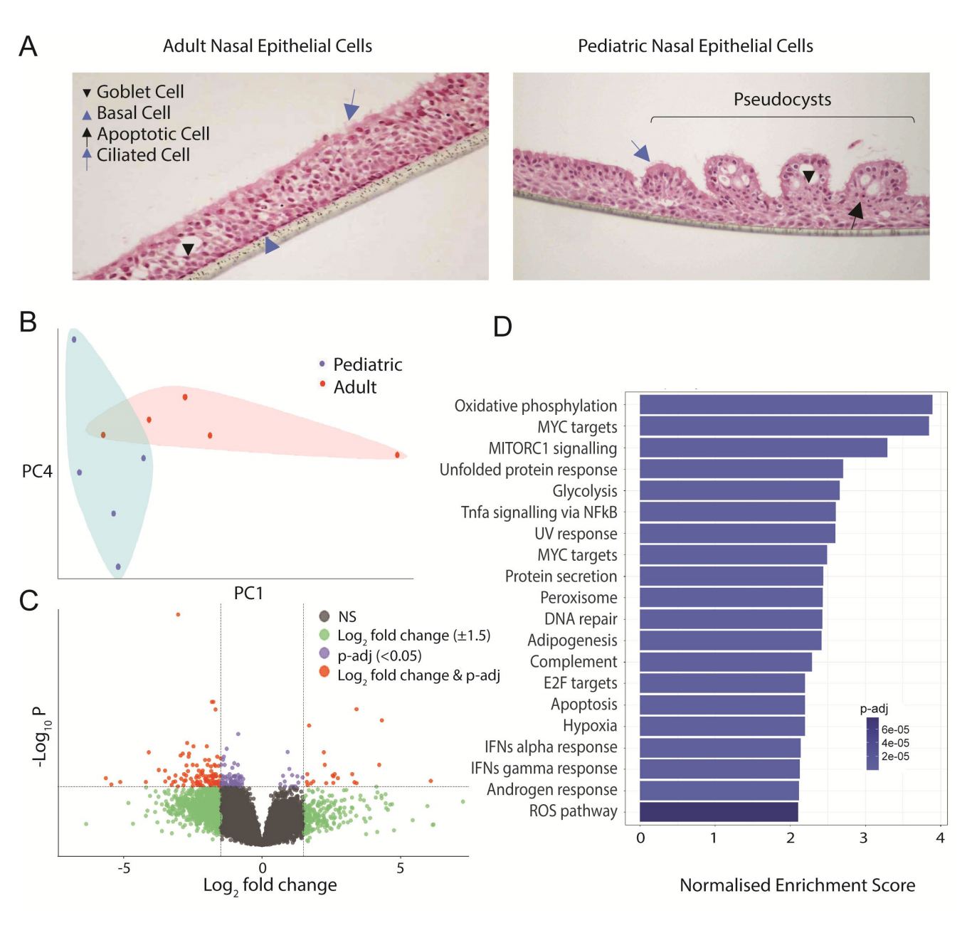
Paediatric and adult nasal epithelial cells are fundamentally different

Slide 15
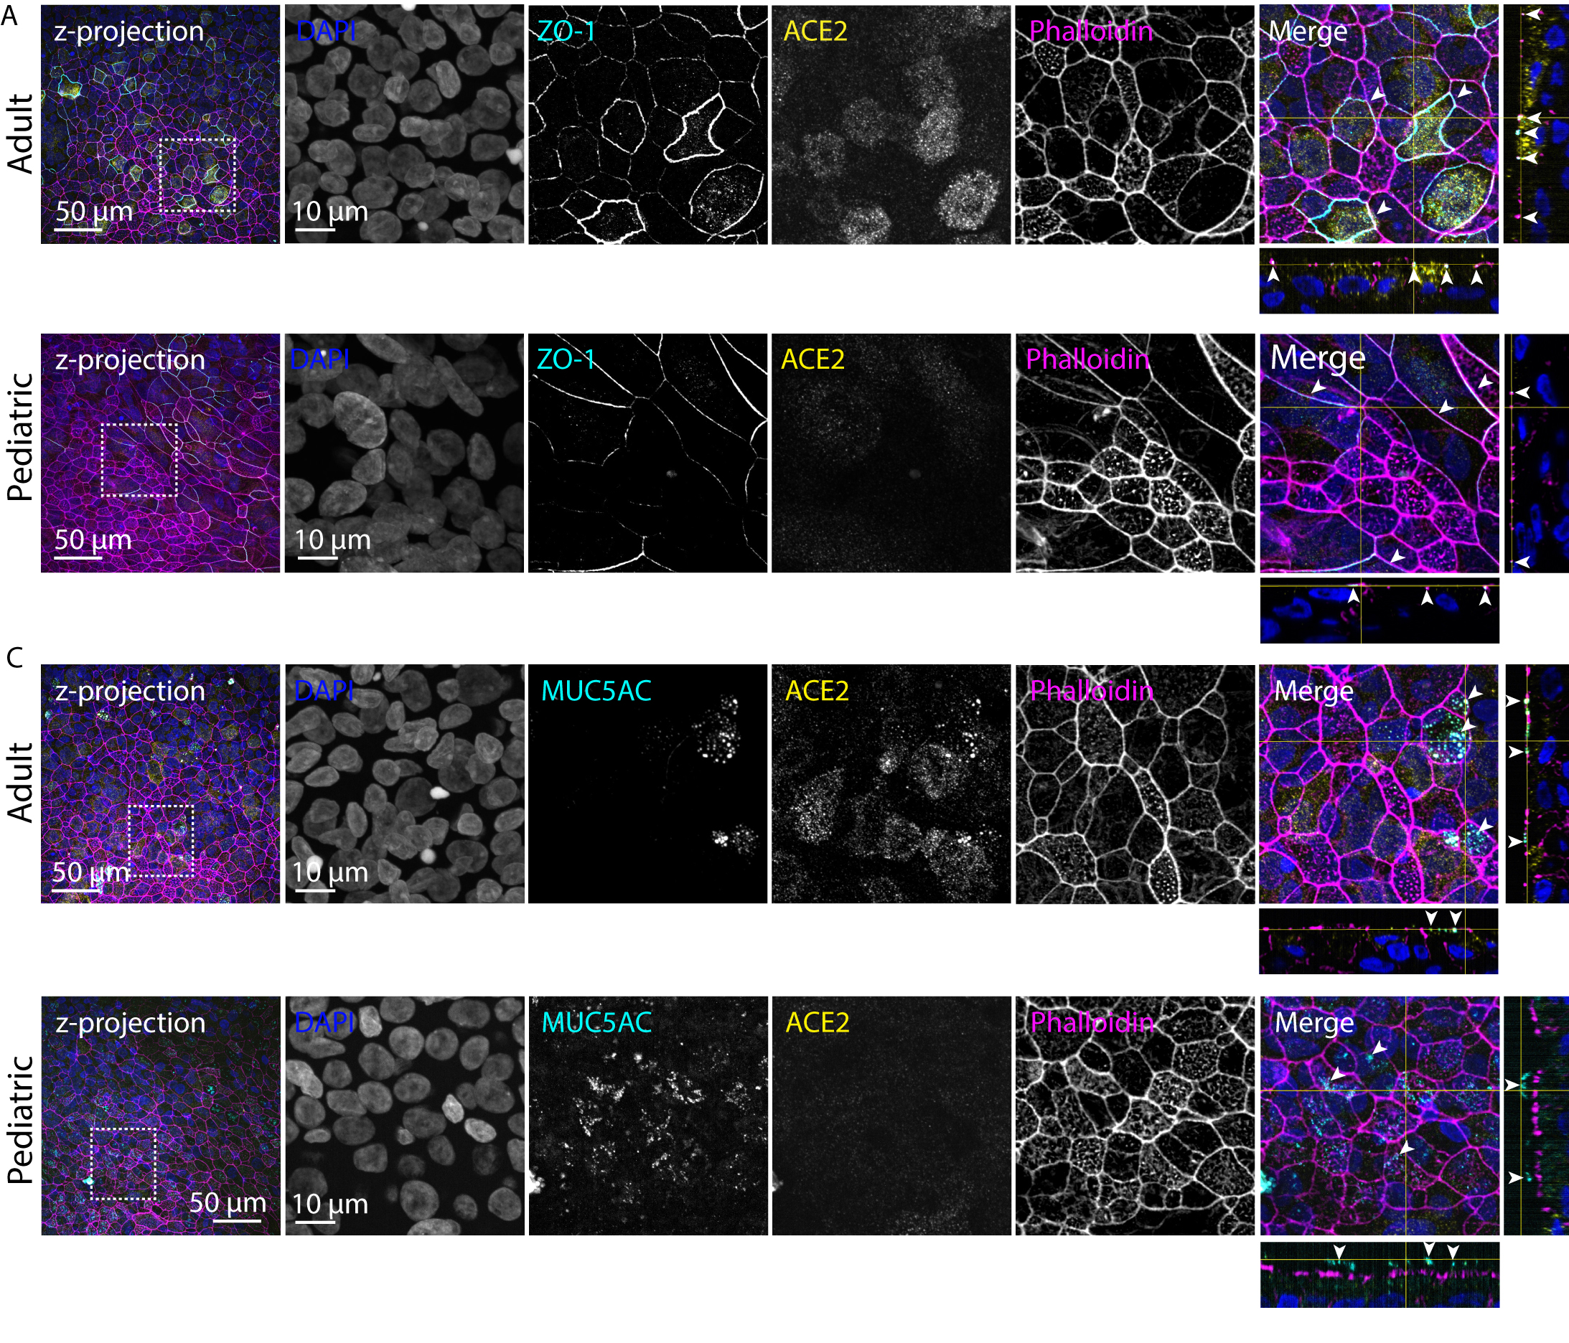
Paediatric and adult nasal epithelial cells are fundamentally different

Slide 16
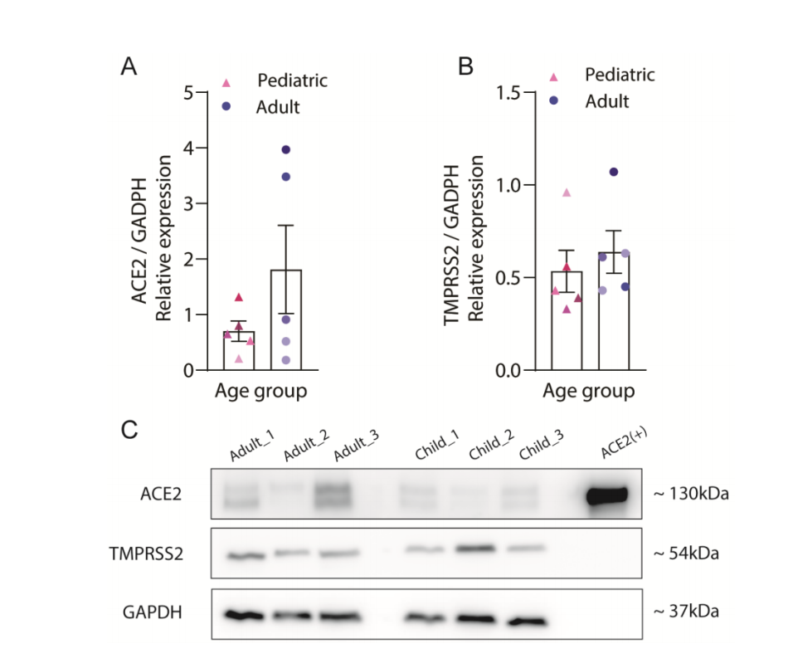
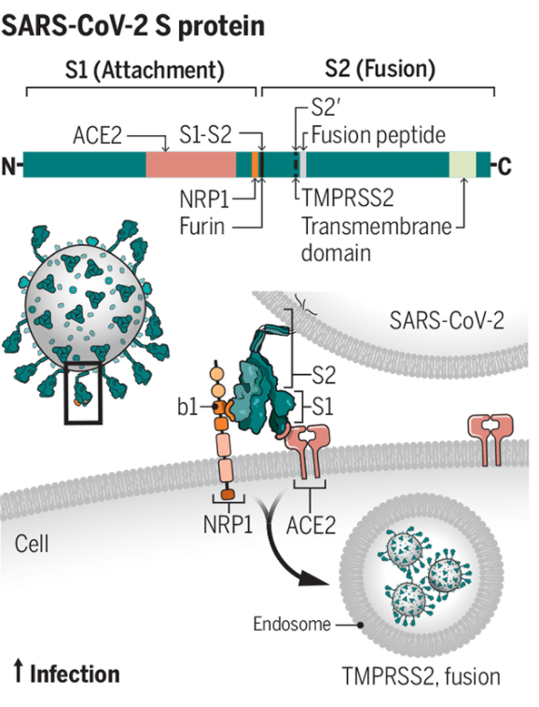
ACE2 and TMPRSS2 expression

Slide 17
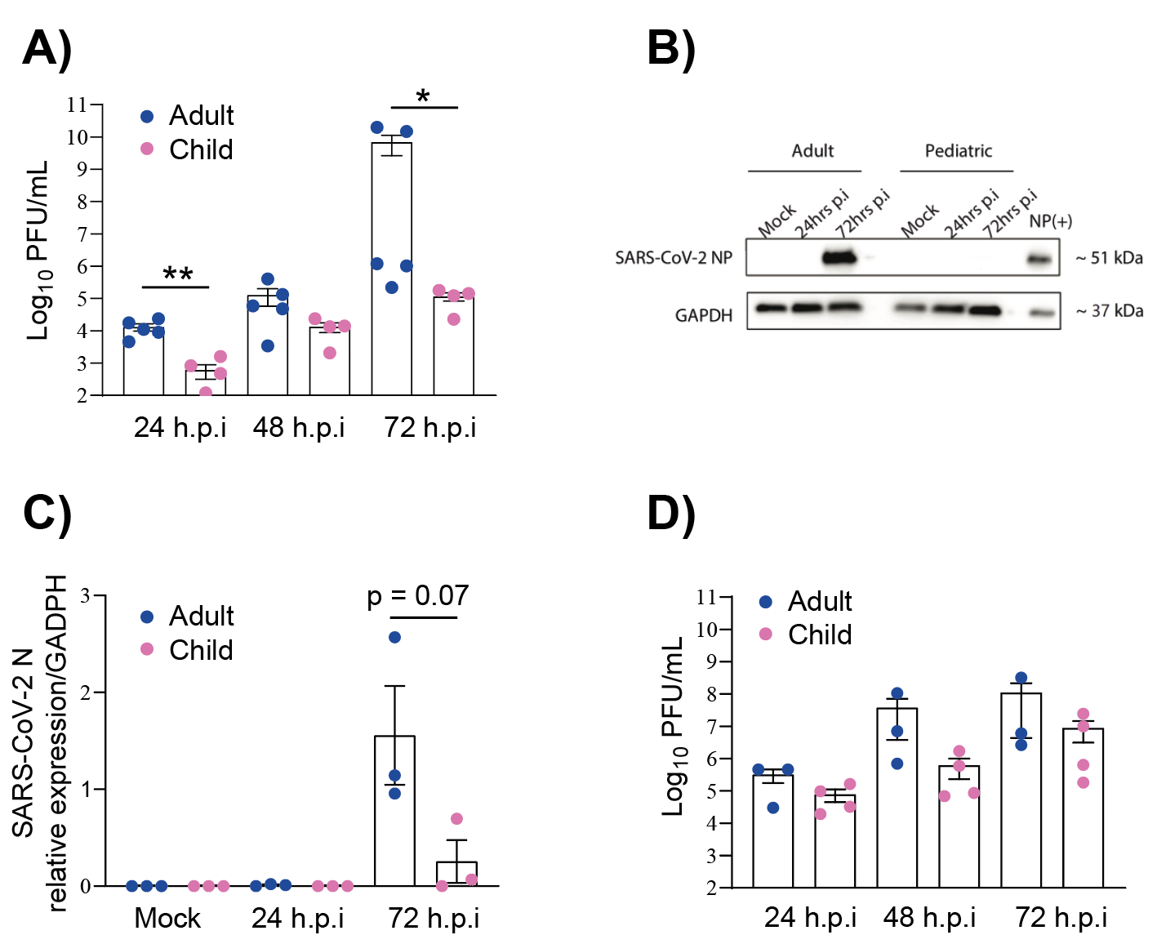
SARS-CoV-2 replicates better in adult epithelial cells

Slide 18
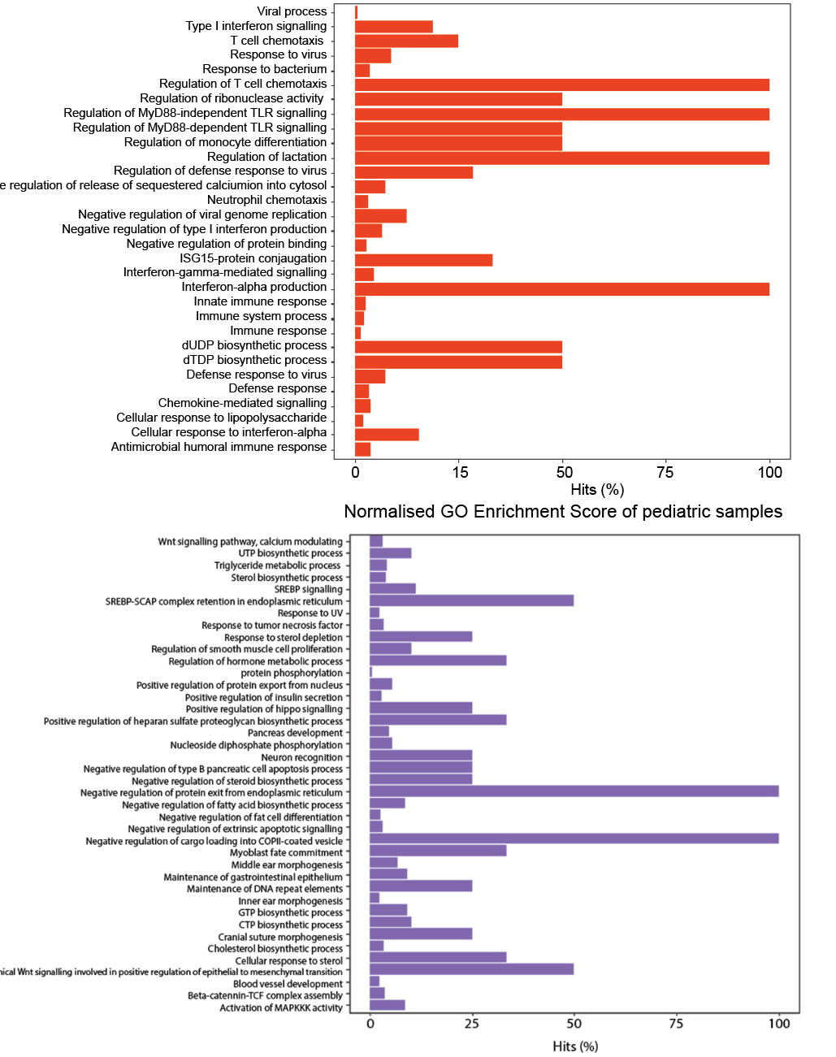


Pediatric nasal epithelial cells mount a strong interferon response to SARS-CoV-2

Slide 19
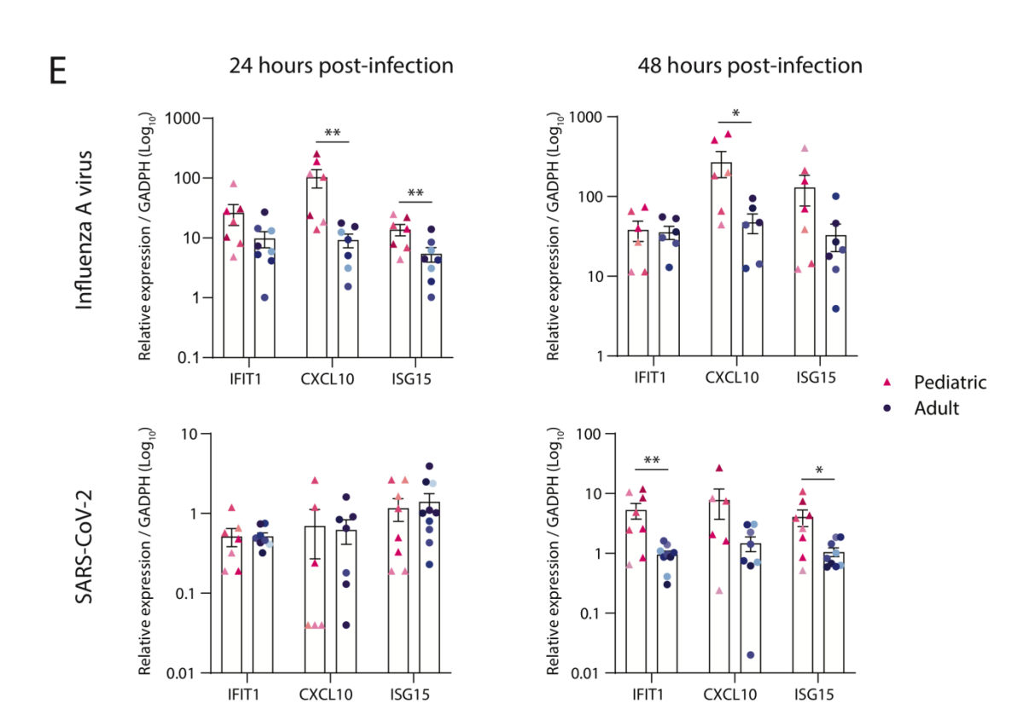
Pediatric nasal epithelial cells mount a strong interferon response to SARS-CoV-2

Slide 20
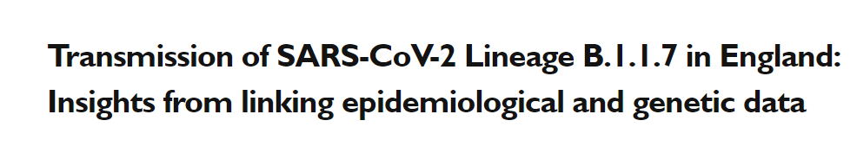
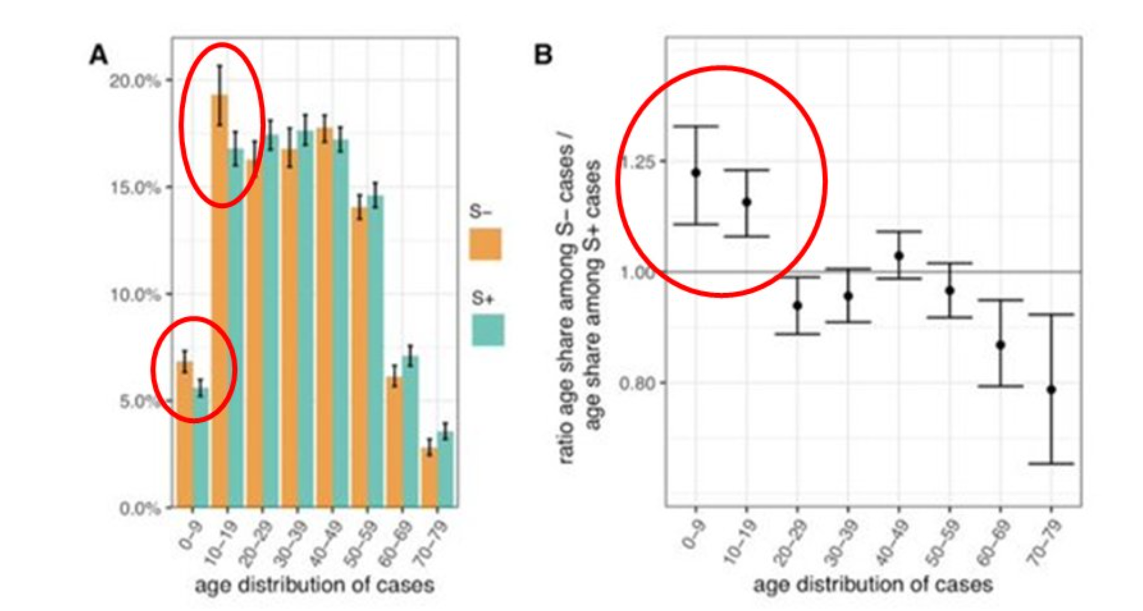
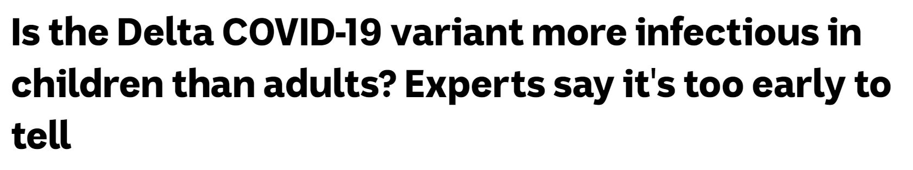
Has this changed with the variants?

Slide 21
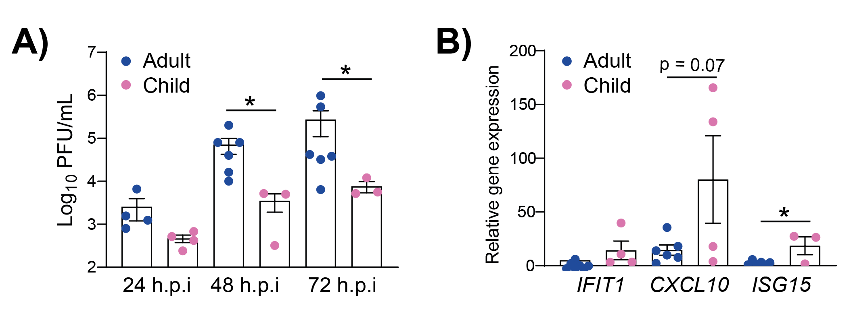
Alpha is no different….

Slide 22
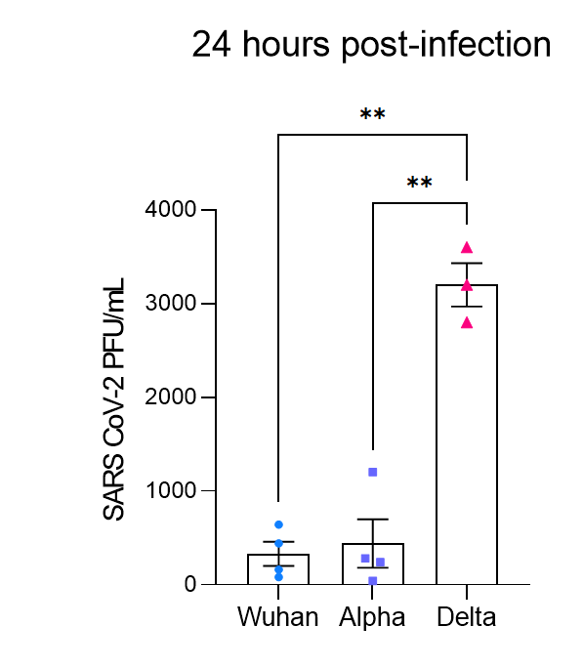
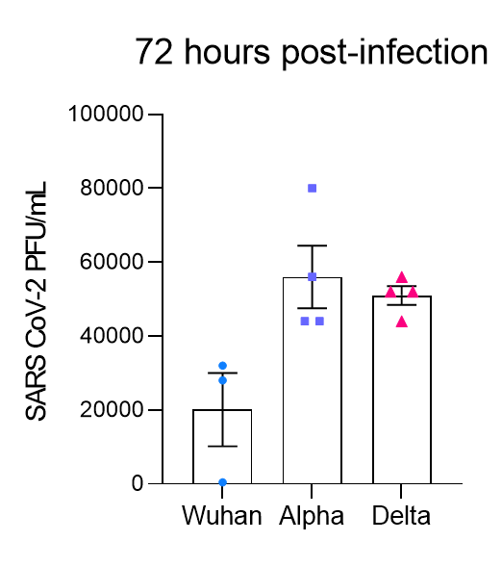
What about delta?
Data using pediatric cells should follow soon!

Slide 23
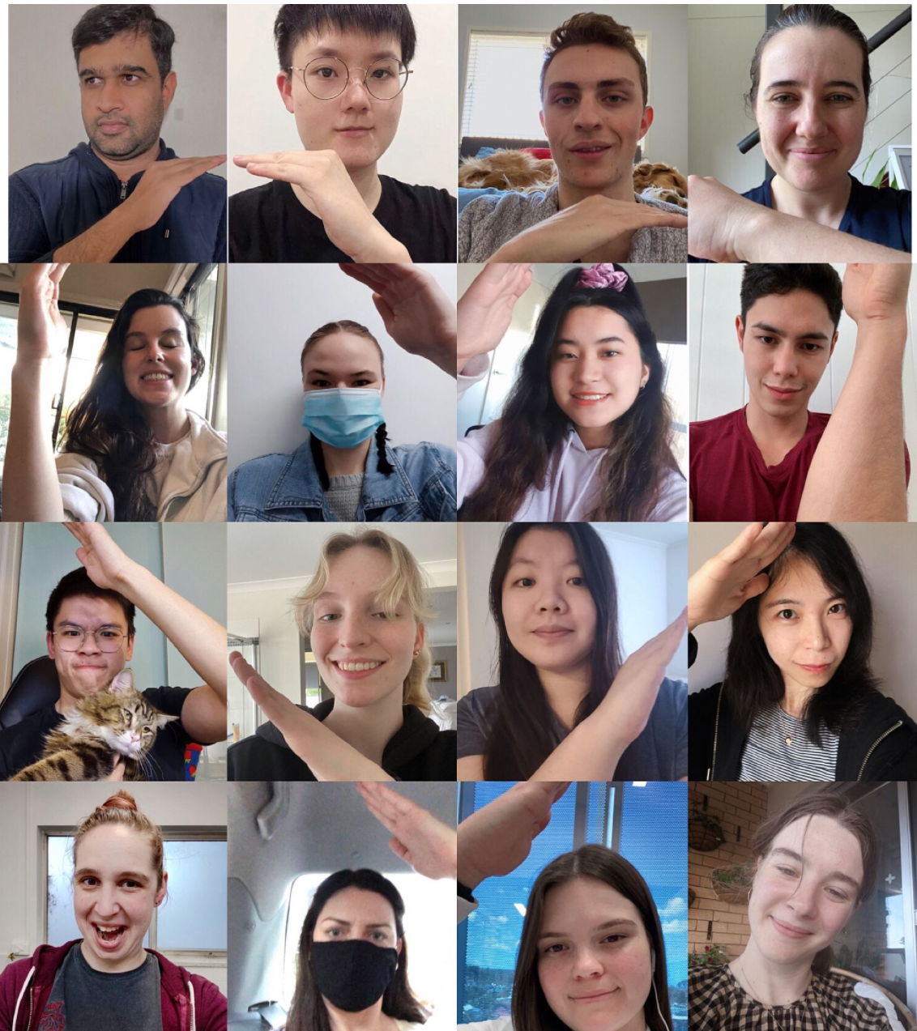






Acknowledgements
Kirsten Spann
Teja Yarlagadda
Asha Bowen
David Martino
Tobias Kollmann
Anthony Kicit
Yanshan Zhu
Anjana Karawita
Keng Yih Chew
Helle Bielefeldt-Ohmann
Larisa Labzin
Claudia Stocks
Giuseppe Balistreri
Merja Joensuu
Frederic Meunier
Peter Sly
Ayaho Yamamoto

